Slide 1
Natural language processing
Lecture 1 – intro

Slide 2
Objectives
Learn how to solve common NLP problems using classical and deep learning approaches.

Slide 3
Prerequisites check
Product rule, sum rule, Bayes’s theorem, likelihood maximization
Classification, clustering, and regression tasks in machine learning
Loss functions, training vs inference, overfitting problem
Optimization techniques, e.g. (stochastic) gradient descent
Deep learning architectures, e.g. Recurrent and Convolutional Neural Networks
Python/Java programming and willingness to learn new tool, e.g. Tensorflow.
We expect your familiarity with Python, since all assignments in this course will use Python, also the Java skill, the project will use Java.
Hardware for the course
We suggest use own hardware, like laptop, SoB(Raspberry Pi, ASUS Tinker Board …)

Slide 4
Main approaches in NLP
Rule-based methods
Regular expressions
Context-free grammars
…
Probabilistic modeling and machine learning
Likelihood maximization
Linear classifiers
…
Deep learning
Recurrent Neural Networks
Convolutional Neural Networks
…
Notes:
There are three main groups of methods in NLP
rule-based approaches, for example regular express.
Traditional machine learning
Deep learning that was recently gained lost of popularity in NLP
I will go through all three approaches just by example of one particular tasks, so you can get some flavor of all of them

Slide 5
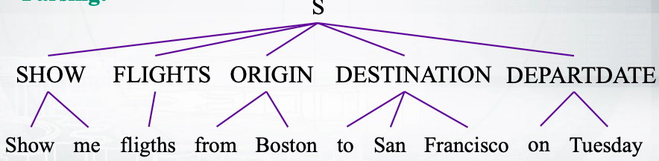
Semantic slot filling: cfg
Context-Free Grammar:
SHOW -> show me | I want | can I see | …
FLIGHTS -> (a) flight | flights
ORIGIN -> from CITY
DESTINATION –> to CITY
CITY -> Boston | San Francisco | Denver | Washington
Parsing
Notes:
The task is called semantic slot filling
You can see the query in the bottom of this slide here which says show me flights from boston to san Francisco on Tuesday, so you have some sequence of words, and you want to find some slots.
The slots would be destinations or departure or some date and something like this.
To fill those slots, you can use different approaches, this slide is about context-free grammars, it’s rule-based approach. This approach to show you what would be the rules to produce some words.
Non terminal word SHOW can produce words, show me, or can I see or something else.
Non terminal words ORIGIN can produce words: from CITY
And CITY non terminal can produce different cities.
Now you have this context-free grammar, you can use it to parse your data. So you can get to the sequence and say what are the non terminals that created this certain words.
Adv. vs DIsAdv.
Do manually, time consuming.
The record of this approach would be not very nice because you can’t write down all the possible cities.
Usually, rule-based approaches have high precision but low recall

Slide 6
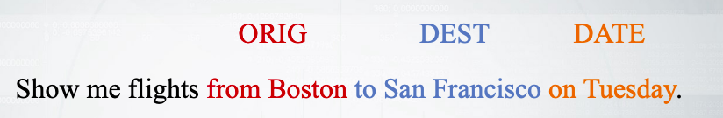
Semantic slot filling: crf
Training corpus
Feature engineering:
is the word capitalized?
Is the word in a list of city names?
What is the previous word?
What is the previous slot?
…
Notes:
Another approach is to build a machine learning system, to do that we need some training data, so we need corpus with some markup.
So here you have a sequence of words and you know that these certain phrases have these certain texts, like origin, destination and date.
After you have your training data, you need to do some feature engineering, so you need to carte features like for example is the word capitalized? …
Then you need define your model, so the probabilistic model would for example produce the probabilities of your text given your words. Generally, these models would have some parameters and they will depend on on features that you have just generated.

Slide 7
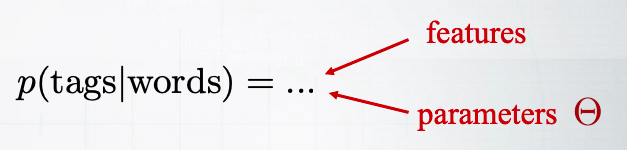
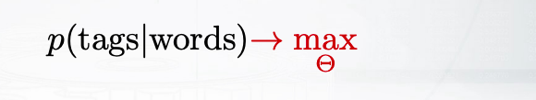
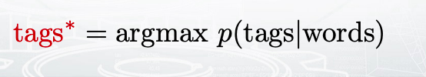
Semantic slot filling: crf
Probabilistic graphical model:
Conditional random field (CRF)
Training:
Inference:
Notes:
Then you need define your model, so the probabilistic model would for example produce the probabilities of your text given your words. Generally, these models would have some parameters and they will depend on on features that you have just generated. And the parameters of the model should be trained. So you will need to take your train data and fit your model to this data. So you will maximize the probability of what you see by the parameters.
This way you will fix the parameters of the model and you will be able to apply this model to the test data.
For the inference you will apply it and you will find the most probable text for your words with some fixed parameters. So this is called inference or test or deployment or something like that.

Slide 8
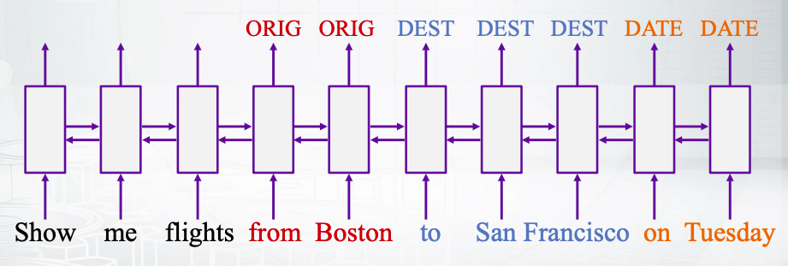
Semantic slot filling: lstm
Big training corpus
No feature generation
Defining the model
Training and inference
Notes:
So this is just the general framework, you have some parameters, you train them and then you apply your model, the similar thing happens for deep learning approach, there you also have this stages but usually you do not have the stage of feature generation.
So what you’re doing is that you just feed your sequence of words as is to some neural network. I’m not going to details into the neural network now. I just show you the idea that you feed your words just as one hot encoders.
As the vectors that have only one non zero element that corresponds to the number of this word in the vocabulary and lots of zeros. So you feed this vectors to some complicated neural network that has some complicated architecture and lots of parameters. You feed this perimeters and then you apply this network to your test data to get the text out of this model.
Deep learning methods really nice for many tasks in NLP

Slide 9
Deep learning vs. traditional nlp
Why do we need to study traditional NLP?
Perform good enough in many tasks
Example: sequence labeling
Allow us not to be blinded with the hype
Example: word2vec / distributional semantics
Can help to further improve DL models
Example: word alignment priors in machine translation
Notes:
So sometimes it feels like we forget about traditional approaches, and there are some reasons not to forget about it.

Slide 10
Groups
Split into groups for project

